Slide 1
Affordable, Accessible, and Expandable Secure Systems for the Post-quantum Era
Lake Bu, Rashmi Agrawal, Alan Ehret
ASCS Lab

Slide 2
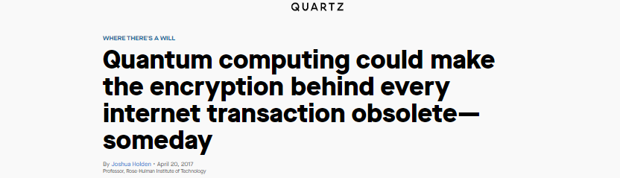
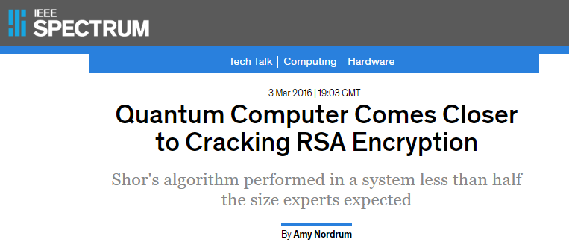
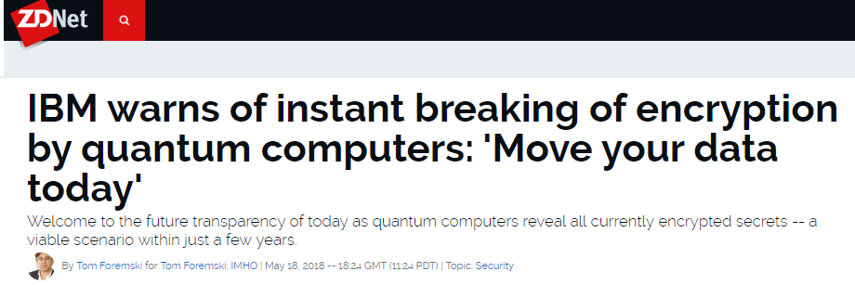
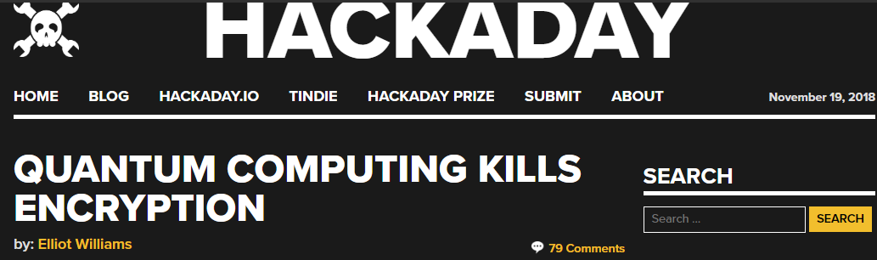
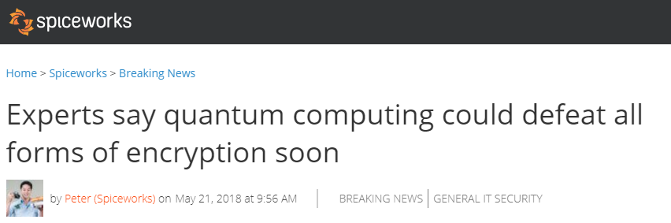
1. What Some Have Said About Quantum Computers

Slide 3
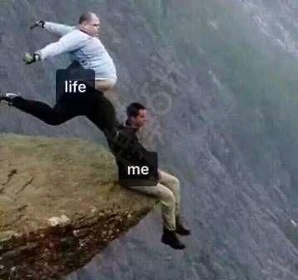
1. What Some Have Said About Quantum Computers
Quantum
Computer
Encryption

Slide 4
2. The Actual Situation Now
Who is considered as non-post-quantum secure?
Victims: banks, smartphone apps, DocuSign,
web surfing, governments, military, etc.
Algorithm | Secure in Post-quantum Era?
RSA-1024, -2048, -4096 | No
Elliptic Curve Crypto (ECC)-256, -521 | No
Diffie-Hellman | No
ECC Diffie-Hellman | No
AES-128, -192 | No

Slide 5
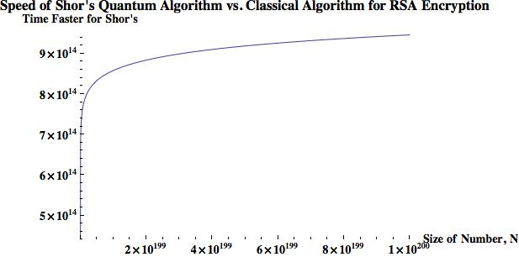
2. The Actual Situation Now
Who is considered as non-post-quantum secure?
*
To break a 768-bit (232 digits) RSA:
2 years for a current super computer
1 nanosecond for a quantum computer
(log N)²(log(log (N))(log(log(log(N)))
N: key size in decimal digits
* Zak Burkley, The Teachings of a Quantum Cat, 2016

Slide 6
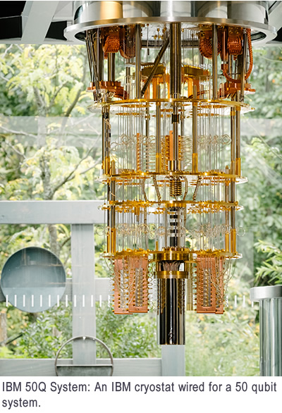
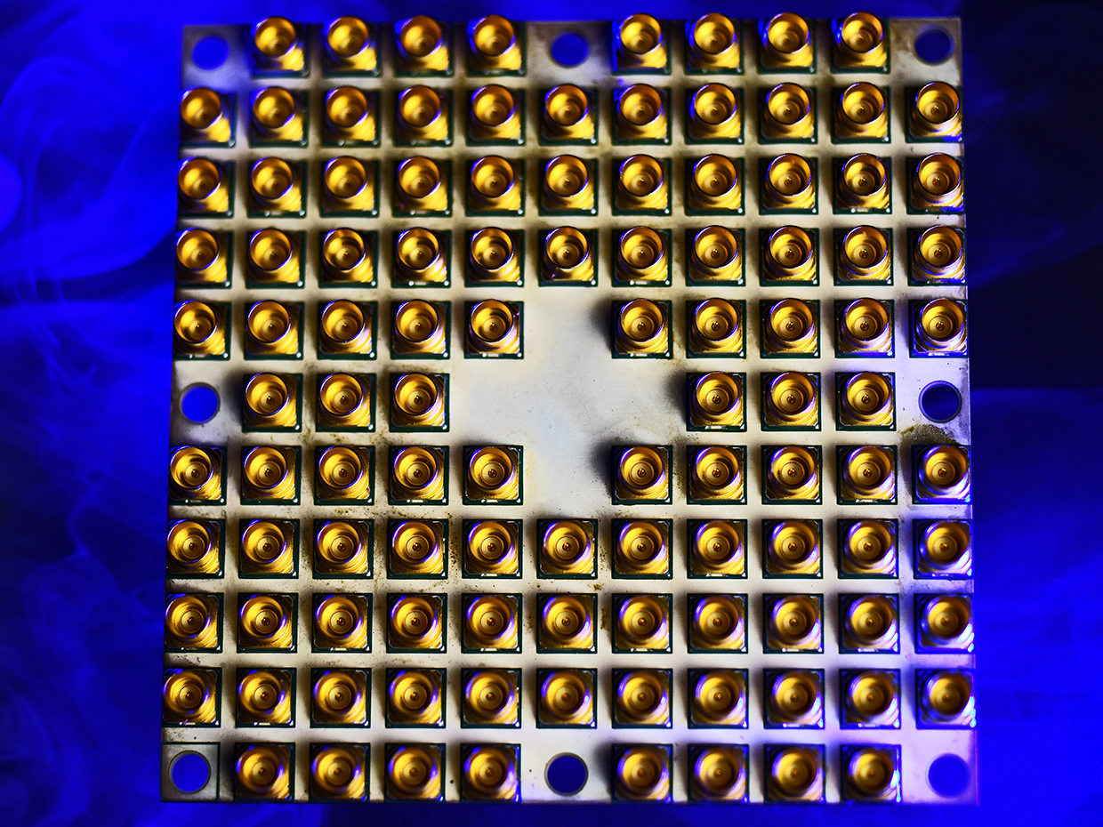
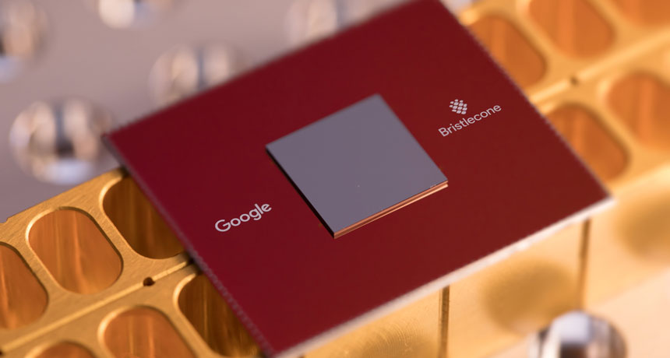
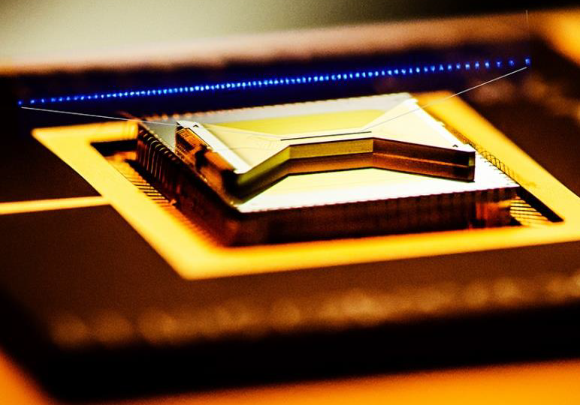
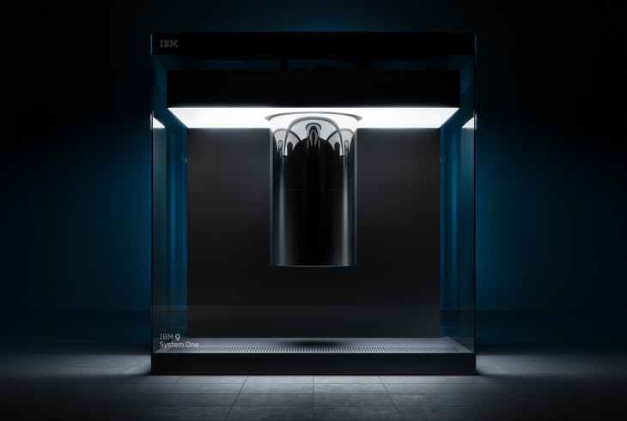
Ongoing Development
Intel 49 Qubits
Google 72 Qubits
IBM 50 Qubits, 20 Qubits
IonQ 160 Qubits
Notes:
This slide shows the ongoing development in the field of Quantum Computers.
Qubits mentioned here are Physical qubits & actual useful qubits or the logical qubits may be just ½ or 2/3 of the physical qubits. Typically many physical qubits get used up to provide stability, error-correction and fault tolerance needed to perform useful computations

Slide 7
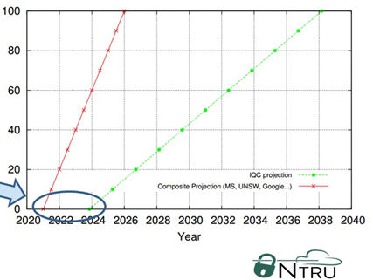
How Far Is It From Us?
The Projected Timeline of General Quantum Computers
Early 2015 Projection
Late 2015 Projection
Threat Window
(1 ~ 5 yr)
[1]
[1] Lee Wilson, The Rise of Quantum Computers – The Current State of Cryptographic Affairs, 2016
Notes:
And how far are we from seeing the quantum supremacy? NTRU published a good insight on this. Early 2015 they projected a timeline that commercial qc will be first available in 2024 and readily available by 2038. But developments in the field made them do second projection in late 2015 saying that commercial qc will be available in 2021 and readily available by 2026. which reduced the window by 5 years. Moreover we know that IBM launched first qc in 2019 which further narrows down the gap.

Slide 8
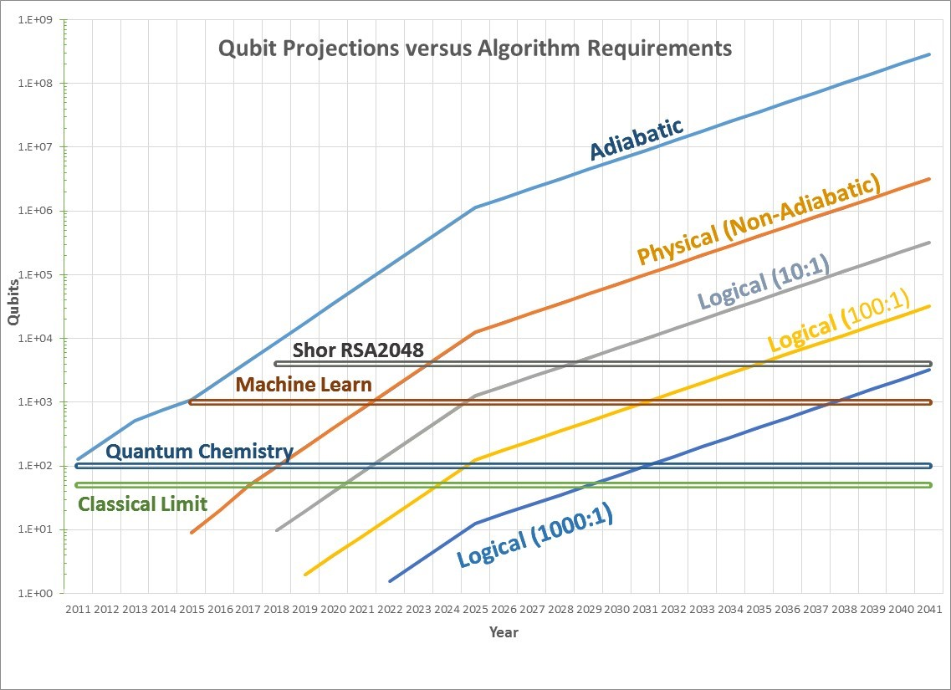
Applying Moore’s Law to Quantum Computers
(1 ~ 5 yr)
[1]
2023
2028
[1] https://quantumcomputingreport.com/our-take/applying-moores-law-to-quantum-qubits/
Notes:
Researchers also started applying Moore’s law to QC and by the past experience from 2011 they found that Moore’s law fits pretty well to QC and they can do reasonable predictions for future. By this prediction RSA will be broken between the year 2023 and 2028 which matches the prediction on the previous slide which is 2026.

Slide 9
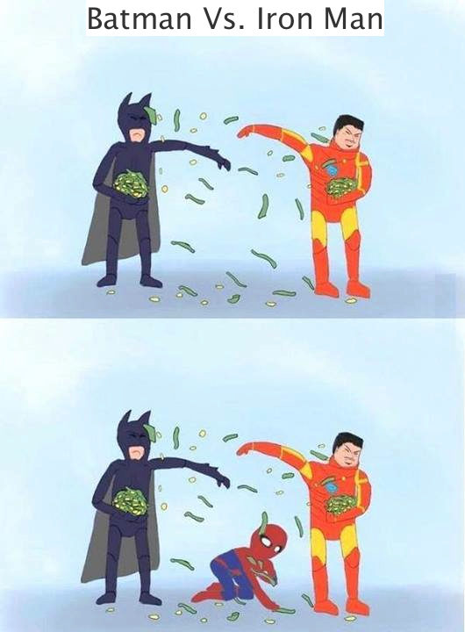
An Affordable, Accessible, and Expandable Solution for the Next 10 Years
Notes:
Having to develop quantum computer-based cryptography is rich man’s solution like Iron man & batman. Developing conventional computer based quantum proof solutions is a common man’s approach like spiderman.

Slide 10


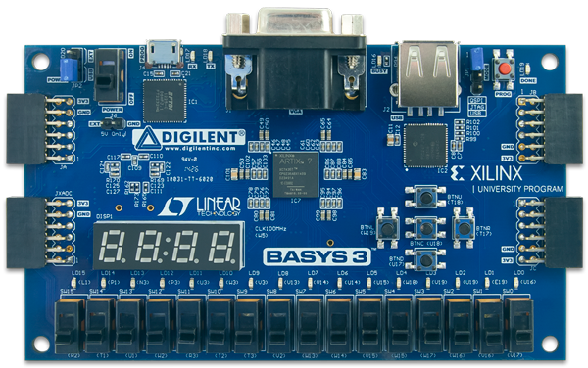
An Affordable, Accessible, and Expandable Solution for the Next 10 Years
Notes:
As soon as one powerful QC can be built by IBM or Google or Intel, all conventional cryptosystems will not be secure. Meaning we can’t publish any papers based on conventional secure schemes. But still it will take at least a decade for everyone to move to quantum computer-based defenses. So, we would envision that, for 5-10 years, silicon based Quantum-Proof solutions such as FPGA will still be mainstream for researchers, banks and various govt. agencies. Another advantage is that what ever Quantum-proof is getting implemented now on FPGA, can still be implemented on Quantum Computers. So, we are building a solution for now and for tomorrow.

Slide 11
Presentation Flow
Motivation: why quantum-proof?
NIST: steps towards standardization
Design Workflow
State of the Art: main algorithm
What we are working on: tool-kit
Notes:
Let’s now see how is NIST doing in standardizing Post-Quantum Crypto

Slide 12
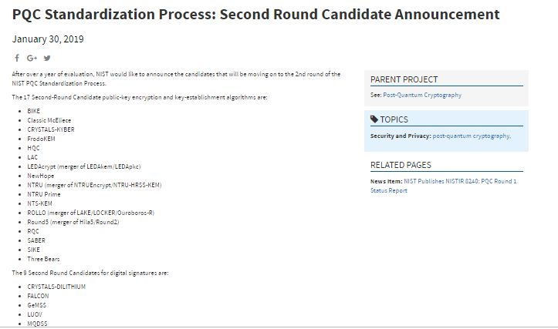
Post-Quantum Cryptography (PQC) Standardization (Round -2)
NIST
Jan 30, 2019 published candidates of Round-2:
27 submissions
Who survived?
12 lattice-based
8 code-based
some multivariate-based and hash based for digital signatures
Notes:
Having said that let’s look at the candidates of second round. On Jan 30, 2019 NIST published first round results. Out of some 69 submissions only 27 submissions were declared as the second round candidates. Who survived the battle? Lattice based, code based and few other multivariate based and some hash-based for digital signatures.

Slide 13
Post-Quantum Cryptography (PQC) Standardization (Round -2)
 | Public-Key Encryption
 | Lattice-based/Ring-LWE |  | Code-based |  | Other
1 | NTRU Prime | (R-lattice) | Classic McEliece | (Binary Goppa)
2 | NTRU European Encryption Standard | (R-lattice) | HQC | (BCH & cyclic)
3 | LAC | (R-LWE) | RQC | (cyclic)
4 | SABER | (Mod-LWR) | LEDA | (LDPC)
5 | Round5 | (R-LWR) | ROLLO (LAKE & LOCKER) | (LRPC)
 | Digital Signature
 | Lattice-based/Ring-LWE
1 | FALCON | (NTRU R-lattice)
2 | qTESLA | (R-LWE)
3 | CRYSTALS-DILITHIUM | (R-LWE)
 | Key Establishment/Encapsulation
 | Lattice-based/Ring-LWE |  | Code-based |  | Other
1 | NewHope | (R-LWE) | BIKE | (MDPC) | SIKE (Isogeny)
2 | NTRU European Encryption Standard | (R-lattice) | NTS-KEM | (Binary Goppa)
3 | FrodoKEM | (R-LWE) | LEDA | (LDPC)
4 | CRYSTALS-KYBER | (R-LWE) | ROLLO (LAKE & LOCKER) | (LRPC)
5 | SABER | (Mod-LWR)
6 | Three Bears | (Mod-LWE)
Notes:
So on the whole we have enough representation in each category and it is a pretty strong candidate.

Slide 14
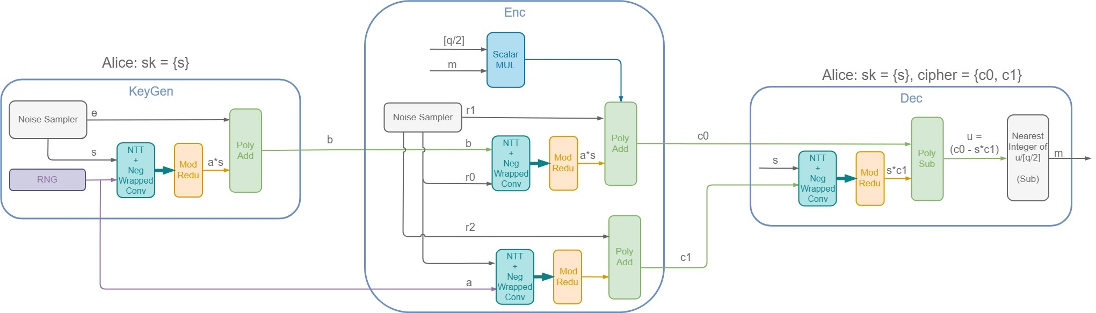



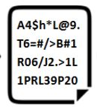
R-LWE Public Key Encryption Co-processor
TRNG
Key Generator
Module
Encryption Module
Decryption Module
Gaussian Noise
Sampler
e
r0, r1, r2
Gaussian Noise
Sampler
[1] Oded Regev, “On lattices, learning with errors, random linear codes, and cryptography”, 2005

Slide 15
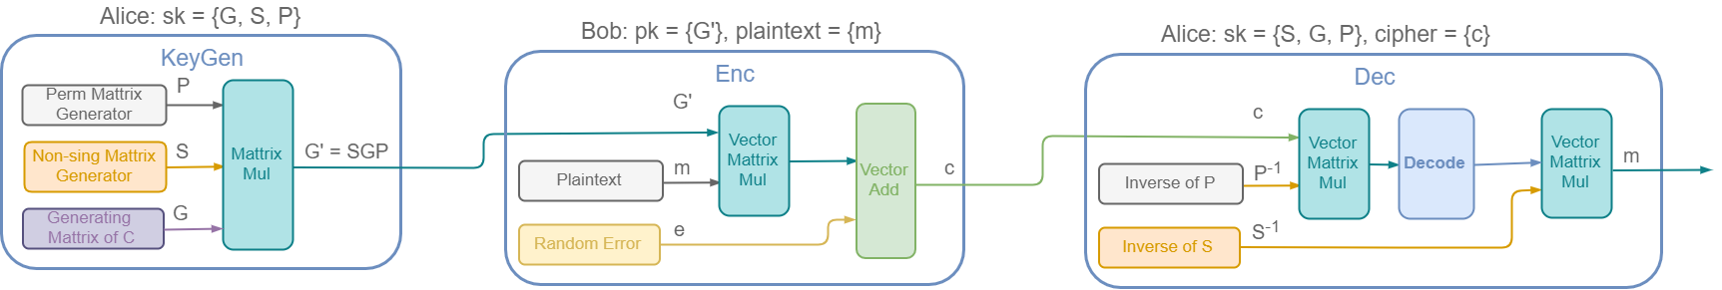
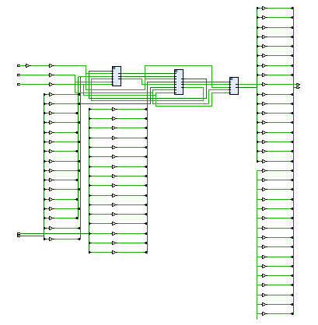
Code-based Encryption
Architecture
Key Generation
Encryption
Decryption

Slide 16


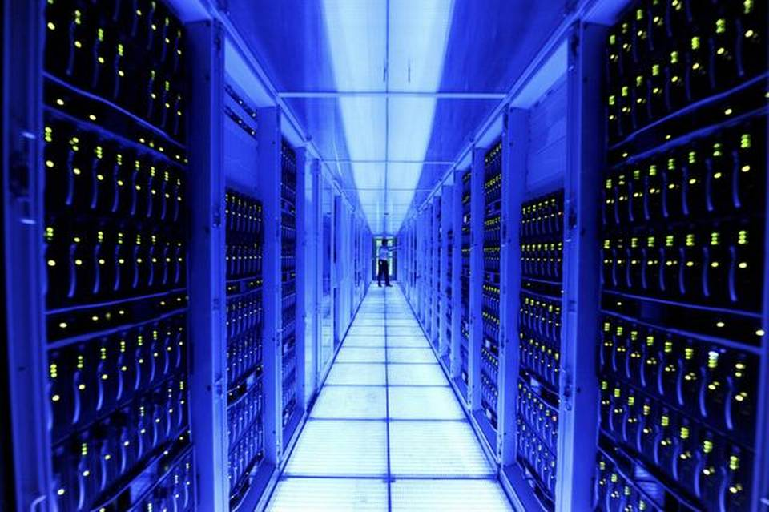
Applications

Slide 17

Any Questions?

